Slide 1
CSG2A3 ALGORITMA dan STRUKTUR DATA
Queue
Linked List Implementation

Slide 2
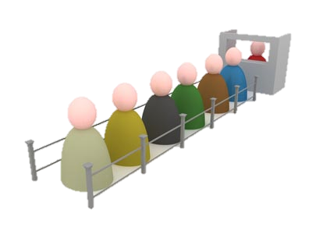
Queue
Arranged in FIFO (First In First Out)
a removal removes and returns the element that has resided in the queue for the longest period of time

Slide 3
Implementation
client-server systems
operating systems: task queue, printing queue
simulation and modeling: air traffic control, urban transport

Slide 4
Queue – in summary
Single Linked list or double linked list with only
Insert Last → add, enqueue
Delete first → del, dequeue
First (L) replaced by HEAD (S)
Last (L) replaced by TAIL (S)

Slide 5
ADT Queue Element
Type infotype : integer
Type address : pointer to ElmQueue
Type ElmQueue <
info : infotype
next : address
>
Type Queue: <
Head: address
Tail : address
>
INFO
NEXT
ElmQueue
Head
Tail
Q

Slide 6
Primitive Operation on Queue
isEmpty : Q → boolean
{true if Q empty; false if otherwise}
isFull : Q → boolean
{true if Q full; false if otherwise}
nbElmt : Q → integer
{return number of element}
createEmpty : → Q
{create a empty Queue}
Add : elmt x Q → Q
{insert element into queue}
Del : Q → Q x elmt
{remove an element from queue}

Slide 7
Array Representation of Queue
Queue is more accurately represented as an array table
There are 3 alternatives to represent queue in an array
Example :
idxMax = 5
Type Queue :
< array [1..idxMax] of integer
Head, Tail : integer >
Q : Queue
Head(Q) ← 0; Tail(Q) ← 0
1 | 2 | 3 | 4 | 5
Head | 0
Tail | 0

Slide 8
Alternative I
Add(Q, 5)
Add(Q, 2)
Add(Q, 7)
Del(Q)
Del(Q)
Add(Q, 4)
Del(Q)
Del(Q)
1 | 2 | 3 | 4 | 5
5
2
7
4
2
7
4
7
0
1
0
1
2
Head
3
Tail
false
true
isEmpty

Slide 9
Alternative I
Add and Remove Element
Tail move back and forth
Represents real life example of queue
Queue of people in a ticket box
Not efficient to implement
Why?

Slide 10
Exercise on Alternative I
Create an algorithm for 1st Alternative
createEmptyQueue → create an empty queue
isEmpty → check if the queue is ‘empty’
isFull → check if the queue is ‘full’
Add → add 1 element to the queue
Del → remove 1 element from the queue
Remember, in C/Cpp (and most of programming language) array start from 0

Slide 11
Alternative II
Add(Q, 5)
Add(Q, 2)
Add(Q, 7)
Del(Q)
Del(Q)
Add(Q, 4)
Del(Q)
Add(Q, 9)
Add(Q, 4)
Del(Q)
Del(Q)
Del(Q)
1 | 2 | 3 | 4 | 5
5
4
2
9
7
4
4
9
0
1
2
3
4
0
1
2
3
4
Head
5
Tail
isEmpty
false
true

Slide 12
Alternative II
Add and Remove Element
Both head and tail move back and forth
Not Representing real life example of queue
But quite efficient to implement
Why?
Define process to move the elements when there is a quasi-full condition on the queue
Queue appear to be full as the tail reach max, but not really because there’s still some space in front of the head

Slide 13
Exercise on Alternative II
Create an algorithm for 2nd Alternative
createEmptyQueue → create an empty queue
isEmpty → check if the queue is ‘empty’
isFull → check if the queue is ‘full’
Add → add 1 element to the queue
Del → remove 1 element from the queue
Remember, in C/Cpp (and most of programming language) array start from 0

Slide 14
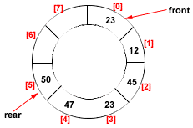
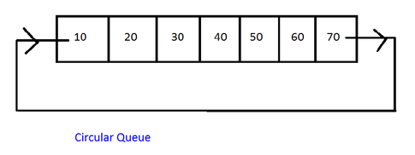
Alternative III
Circular queue
Ring buffer / circular buffer

Slide 15

Alternative III
Add(Q, 5)
Add(Q, 2)
Add(Q, 7)
Del(Q)
Del(Q)
Add(Q, 4)
Del(Q)
Add(Q, 9)
Add(Q, 4)
Add(Q, 8)
Del(Q)
Del(Q)
Del(Q)
Del(Q)
5
1
5
9
4
2
4
8
4
2
7
3
0
1
2
3
4
5
0
1
2
3
4
Head
5
Tail
isEmpty
false
true

Slide 16
Alternative III
Add(Q, 5)
Add(Q, 2)
Add(Q, 7)
Del(Q)
Del(Q)
Add(Q, 4)
Del(Q)
Add(Q, 9)
Add(Q, 4)
Add(Q, 8)
Del(Q)
Del(Q)
Del(Q)
Del(Q)
1 | 2 | 3 | 4 | 5
5
4
2
8
7
4
9
0
1
2
3
4
5
0
1
2
3
4
Head
5
Tail
isEmpty
false
true

Slide 17
Alternative III
Add and Remove Element
Both head and tail always move forward
When max queue is reached, try to circle around
The most efficient among the three options
Why?

Slide 18
Exercise on Alternative III
Create an algorithm for 3rd Alternative
createEmptyQueue → create an empty queue
isEmpty → check if the queue is ‘empty’
isFull → check if the queue is ‘full’
Add → add 1 element to the queue
Del → remove 1 element from the queue
Remember, in C/Cpp (and most of programming language) array start from 0

Slide 19
Question?

Slide 20
Home Task - Summary
Write the algorithm of queue mechanism using
Single linked list
Array alternative 1
Array alternative 2
Array alternative 3
Use the same infotype as before
Each member is to write 1 mechanism

